Slide 1
def count_chars(str):
upper_ctr, lower_ctr, number_ctr, special_ctr = 0, 0, 0, 0
for i in range(len(str)):
if str[i] >= 'A' and str[i] <= 'Z':
upper_ctr += 1
elif str[i] >= 'a' and str[i] <= 'z':
lower_ctr += 1
elif str[i] >= '0' and str[i] <= '9':
number_ctr += 1
else:
special_ctr += 1
return upper_ctr, lower_ctr, number_ctr, special_ctr
str = "Sathyabama2019@“
print("Original Substrings:",str)
u, l, n, s = count_chars(str)
a=u+l
print('\nDigits: ‘,n)
print('Alphabets: ‘,a)
print('Special Characters: ‘,s)
print('Lowercase: ‘,l)
print('Uppercase: ',u)

Slide 2
Data Preprocessing in Machine learning
Data preprocessing is a process of preparing the raw data and making it suitable for a machine learning model. It is the first and crucial step while creating a machine learning model.
When creating a machine learning project, it is not always a case that we come across the clean and formatted data. And while doing any operation with data, it is mandatory to clean it and put in a formatted way.

Slide 3
A real-world data generally contains noises, missing values, and maybe in an unusable format which cannot be directly used for machine learning models. Data preprocessing is required tasks for cleaning the data and making it suitable for a machine learning model which also increases the accuracy and efficiency of a machine learning model.

Slide 4
It involves below steps:
Getting the dataset
Importing libraries
Importing datasets
Finding Missing Data
Encoding Categorical Data
Splitting dataset into training and test set
Feature scaling

Slide 5
1) Get the Dataset
To create a machine learning model, the first thing we required is a dataset as a machine learning model completely works on data. The collected data for a particular problem in a proper format is known as the dataset.

Slide 6
Dataset may be of different formats for different purposes, such as, if we want to create a machine learning model for business purpose, then dataset will be different with the dataset required for a liver patient. So each dataset is different from another dataset. To use the dataset in our code, we usually put it into a CSV file. However, sometimes, we may also need to use an HTML or xlsx file.

Slide 7
What is a CSV File?

Slide 8
CSV stands for "Comma-Separated Values" files; it is a file format which allows us to save the tabular data, such as spreadsheets. It is useful for huge datasets and can use these datasets in programs.

Slide 9
2) Importing Libraries
In order to perform data preprocessing using Python, we need to import some predefined Python libraries. These libraries are used to perform some specific jobs. There are three specific libraries that we will use for data preprocessing, which are:

Slide 10
Numpy: Numpy Python library is used for including any type of mathematical operation in the code. It is the fundamental package for scientific calculation in Python. It also supports to add large, multidimensional arrays and matrices. So, in Python,
we can import it as:
import numpy as nm
Here we have used nm, which is a short name for Numpy, and it will be used in the whole program.

Slide 11
Matplotlib: The second library is matplotlib, which is a Python 2D plotting library, and with this library, we need to import a sub-library pyplot. This library is used to plot any type of charts in Python for the code. It will be imported as below:
import matplotlib.pyplot as mpt
Here we have used mpt as a short name for this library.

Slide 12

Pandas: The last library is the Pandas library, which is one of the most famous Python libraries and used for importing and managing the datasets. It is an open-source data manipulation and analysis library.
Here, we have used pd as a short name for this library. Consider the below image:

Slide 13
3) Importing the Datasets
Now we need to import the datasets which we have collected for our machine learning project. But before importing a dataset, we need to set the current directory as a working directory. To set a working directory in Spyder IDE, we need to follow the below steps:

Slide 14
Save your Python file in the directory which contains dataset.
Go to File explorer option in Spyder IDE, and select the required directory.
Click on F5 button or run option to execute the file.

Slide 15
Here, in the below image, we can see the Python file along with required dataset. Now, the current folder is set as a working directory.

Slide 16
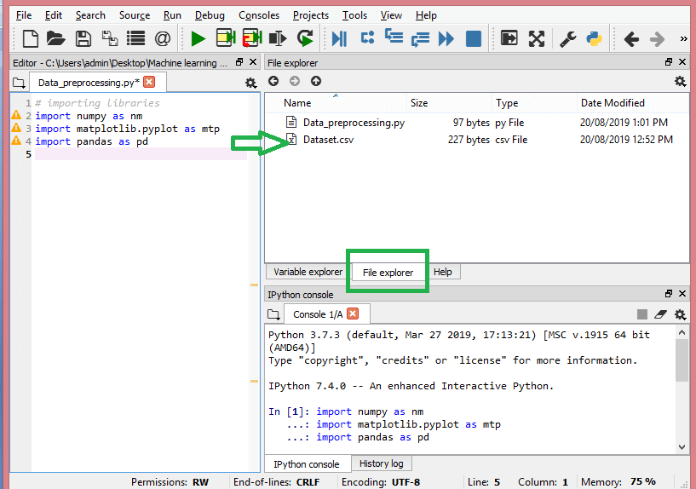

Slide 17
read_csv() function:
Now to import the dataset, we will use read_csv() function of pandas library, which is used to read a csv file and performs various operations on it. Using this function, we can read a csv file locally as well as through an URL.

Slide 18
We can use read_csv function as below:
data_set= pd.read_csv('Dataset.csv')

Slide 19
Here, data_set is a name of the variable to store our dataset, and inside the function, we have passed the name of our dataset. Once we execute the above line of code, it will successfully import the dataset in our code. We can also check the imported dataset by clicking on the section variable explorer, and then double click on data_set.

Slide 20
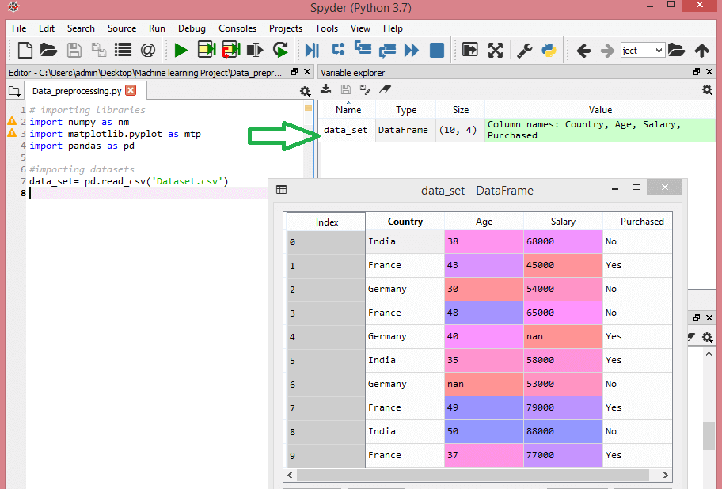

Slide 21
As in the image, indexing is started from 0, which is the default indexing in Python. We can also change the format of our dataset by clicking on the format option.

Slide 22
Extracting dependent and independent variables:
In machine learning, it is important to distinguish the matrix of features (independent variables) and dependent variables from dataset. In our dataset, there are three independent variables that are Country, Age, and Salary, and one is a dependent variable which is Purchased.

Slide 23
Extracting independent variable:
To extract an independent variable, we will use iloc[ ] method of Pandas library. It is used to extract the required rows and columns from the dataset.
x= data_set.iloc[:,:-1].values

Slide 24
in the above code, the first colon(:) is used to take all the rows, and the second colon(:) is for all the columns. Here we have used :-1, because we don't want to take the last column as it contains the dependent variable. So by doing this, we will get the matrix of features.

Slide 25
By executing the above code, we will get output as:
[['India' 38.0 68000.0]
['France' 43.0 45000.0]
['Germany' 30.0 54000.0]
['France' 48.0 65000.0]
['Germany' 40.0 nan]
['India' 35.0 58000.0]
['Germany' nan 53000.0]
['France' 49.0 79000.0]
['India' 50.0 88000.0]
['France' 37.0 77000.0]]

Slide 26
Extracting dependent variable:
To extract dependent variables, again, we will use Pandas .iloc[] method.
y= data_set.iloc[:,3].values
Here we have taken all the rows with the last column only. It will give the array of dependent variables.

Slide 27
By executing the above code, we will get output as:
Output:
array(['No', 'Yes', 'No', 'No', 'Yes', 'Yes', 'No', 'Yes', 'No', 'Yes'],
dtype=object)

Slide 28
4) Handling Missing data:

Slide 29
The next step of data preprocessing is to handle missing data in the datasets. If our dataset contains some missing data, then it may create a huge problem for our machine learning model. Hence it is necessary to handle missing values present in the dataset.

Slide 30
Ways to handle missing data:
There are mainly two ways to handle missing data, which are:
By deleting the particular row: The first way is used to commonly deal with null values. In this way, we just delete the specific row or column which consists of null values. But this way is not so efficient and removing data may lead to loss of information which will not give the accurate output.

Slide 31
By calculating the mean: In this way, we will calculate the mean of that column or row which contains any missing value and will put it on the place of missing value. This strategy is useful for the features which have numeric data such as age, salary, year, etc. Here, we will use this approach.
To handle missing values, we will use Scikit-learn library in our code, which contains various libraries for building machine learning models. Here we will use Imputer class of sklearn.preprocessing library. Below is the code for it:

Slide 32
#handling missing data (Replacing missing data with the mean value)
from sklearn.preprocessing import Imputer
imputer= Imputer(missing_values ='NaN', strategy='mean', axis = 0)
#Fitting imputer object to the independent variables x.
imputerimputer= imputer.fit(x[:, 1:3])
#Replacing missing data with the calculated mean value
x[:, 1:3]= imputer.transform(x[:, 1:3])

Slide 33
Output:
array([['India', 38.0, 68000.0],
['France', 43.0, 45000.0],
['Germany', 30.0, 54000.0],
['France', 48.0, 65000.0],
['Germany', 40.0, 65222.22222222222],
['India', 35.0, 58000.0],
['Germany', 41.111111111111114, 53000.0],
['France', 49.0, 79000.0],
['India', 50.0, 88000.0],
['France', 37.0, 77000.0]], dtype=object
As we can see in the above output, the missing values have been replaced with the means of rest column values.

Slide 34
5) Encoding Categorical data:
Categorical data is data which has some categories such as, in our dataset; there are two categorical variable, Country, and Purchased.
Since machine learning model completely works on mathematics and numbers, but if our dataset would have a categorical variable, then it may create trouble while building the model. So it is necessary to encode these categorical variables into numbers.

Slide 35
For Country variable:
Firstly, we will convert the country variables into categorical data. So to do this, we will use LabelEncoder() class from preprocessing library.

Slide 36
#Catgorical data
#for Country Variable
from sklearn.preprocessing import LabelEncoder
label_encoder_x= LabelEncoder()
x[:, 0]= label_encoder_x.fit_transform(x[:, 0])

Slide 37
Output:
Out[15]:
array([[2, 38.0, 68000.0],
[0, 43.0, 45000.0],
[1, 30.0, 54000.0],
[0, 48.0, 65000.0],
[1, 40.0, 65222.22222222222],
[2, 35.0, 58000.0],
[1, 41.111111111111114, 53000.0],
[0, 49.0, 79000.0],
[2, 50.0, 88000.0],
[0, 37.0, 77000.0]], dtype=object)

Slide 38
Explanation:
In above code, we have imported LabelEncoder class of sklearn library. This class has successfully encoded the variables into digits.
But in our case, there are three country variables, and as we can see in the above output, these variables are encoded into 0, 1, and 2. By these values, the machine learning model may assume that there is some correlation between these variables which will produce the wrong output. So to remove this issue, we will use dummy encoding.

Slide 39
Dummy Variables:
Dummy variables are those variables which have values 0 or 1. The 1 value gives the presence of that variable in a particular column, and rest variables become 0. With dummy encoding, we will have a number of columns equal to the number of categories.

Slide 40
In our dataset, we have 3 categories so it will produce three columns having 0 and 1 values. For Dummy Encoding, we will use OneHotEncoder class of preprocessing library.

Slide 41
#for Country Variable
from sklearn.preprocessing import LabelEncoder, OneHotEncoder
label_encoder_x= LabelEncoder()
x[:, 0]= label_encoder_x.fit_transform(x[:, 0])
#Encoding for dummy variables
onehot_encoder= OneHotEncoder(categorical_features= [0])
x= onehot_encoder.fit_transform(x).toarray()

Slide 42
Output:
array([[0.00000000e+00, 0.00000000e+00, 1.00000000e+00, 3.80000000e+01,
6.80000000e+04],
[1.00000000e+00, 0.00000000e+00, 0.00000000e+00, 4.30000000e+01,
4.50000000e+04],
[0.00000000e+00, 1.00000000e+00, 0.00000000e+00, 3.00000000e+01,
5.40000000e+04],
[1.00000000e+00, 0.00000000e+00, 0.00000000e+00, 4.80000000e+01,
6.50000000e+04],
[0.00000000e+00, 1.00000000e+00, 0.00000000e+00, 4.00000000e+01,
6.52222222e+04],
[0.00000000e+00, 0.00000000e+00, 1.00000000e+00, 3.50000000e+01,
5.80000000e+04],
[0.00000000e+00, 1.00000000e+00, 0.00000000e+00, 4.11111111e+01,
5.30000000e+04],
[1.00000000e+00, 0.00000000e+00, 0.00000000e+00, 4.90000000e+01,
7.90000000e+04],
[0.00000000e+00, 0.00000000e+00, 1.00000000e+00, 5.00000000e+01,
8.80000000e+04],
[1.00000000e+00, 0.00000000e+00, 0.00000000e+00, 3.70000000e+01,
7.70000000e+04]])

Slide 43
As we can see in the above output, all the variables are encoded into numbers 0 and 1 and divided into three columns.
It can be seen more clearly in the variables explorer section, by clicking on x option as:

Slide 44
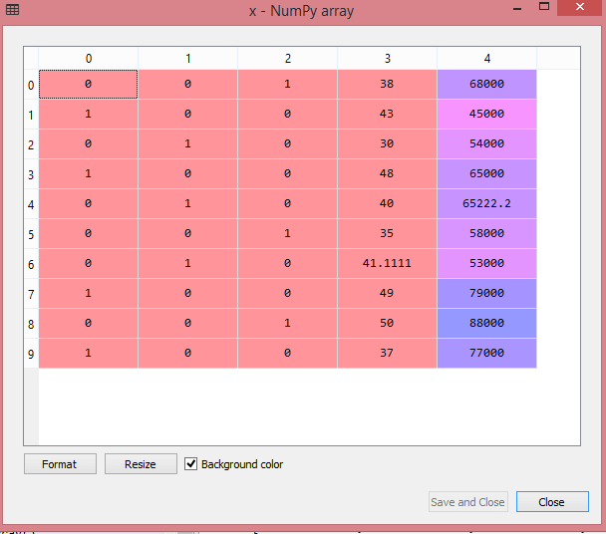

Slide 45
For Purchased Variable:
labelencoder_y= LabelEncoder()
y= labelencoder_y.fit_transform(y)
For the second categorical variable, we will only use labelencoder object of LableEncoder class. Here we are not using OneHotEncoder class because the purchased variable has only two categories yes or no, and which are automatically encoded into 0 and 1.

Slide 46
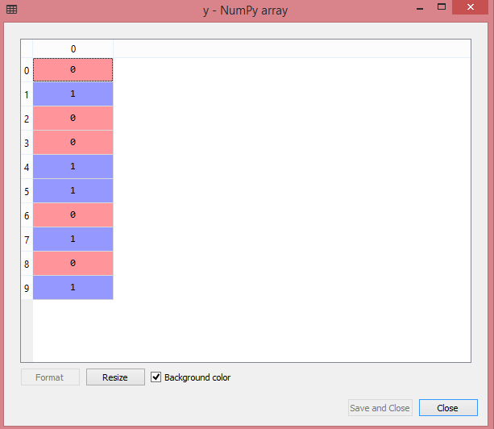
Output:
Out[17]: array([0, 1, 0, 0, 1, 1, 0, 1, 0, 1])
It can also be seen as:

Slide 47
6) Splitting the Dataset into the Training set and Test set
In machine learning data preprocessing, we divide our dataset into a training set and test set. This is one of the crucial steps of data preprocessing as by doing this, we can enhance the performance of our machine learning model.
Suppose, if we have given training to our machine learning model by a dataset and we test it by a completely different dataset. Then, it will create difficulties for our model to understand the correlations between the models.

Slide 48
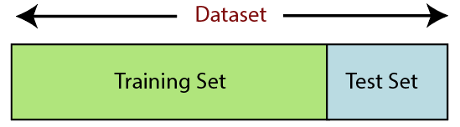
If we train our model very well and its training accuracy is also very high, but we provide a new dataset to it, then it will decrease the performance. So we always try to make a machine learning model which performs well with the training set and also with the test dataset. Here, we can define these datasets as:

Slide 49
Training Set: A subset of dataset to train the machine learning model, and we already know the output.
Test set: A subset of dataset to test the machine learning model, and by using the test set, model predicts the output.

Slide 50
For splitting the dataset, we will use the below lines of code:
from sklearn.model_selection import train_test_split
x_train, x_test, y_train, y_test= train_test_split(x, y, test_size= 0.2, random_state=0)

Slide 51
Explanation:
In the above code, the first line is used for splitting arrays of the dataset into random train and test subsets.
In the second line, we have used four variables for our output that are
x_train: features for the training data
x_test: features for testing data
y_train: Dependent variables for training data
y_test: Independent variable for testing data

Slide 52
In train_test_split() function, we have passed four parameters in which first two are for arrays of data, and test_size is for specifying the size of the test set. The test_size maybe .5, .3, or .2, which tells the dividing ratio of training and testing sets.
The last parameter random_state is used to set a seed for a random generator so that you always get the same result, and the most used value for this

Slide 53
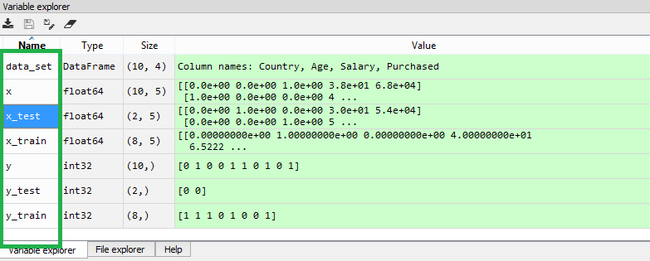
Output:
By executing the above code, we will get 4 different variables, which can be seen under the variable explorer section.
As we can see in the above image, the x and y variables are divided into 4 different variables with corresponding values.

Slide 54
7) Feature Scaling
Feature scaling is the final step of data preprocessing in machine learning. It is a technique to standardize the independent variables of the dataset in a specific range. In feature scaling, we put our variables in the same range and in the same scale so that no any variable dominate the other variable.

Slide 55
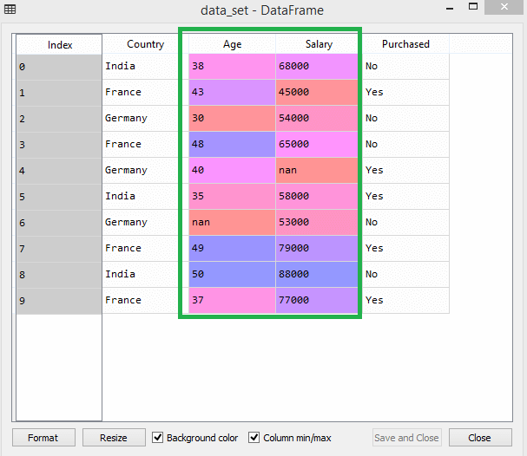

Slide 56
As we can see, the age and salary column values are not on the same scale. A machine learning model is based on Euclidean distance, and if we do not scale the variable, then it will cause some issue in our machine learning model.

Slide 57
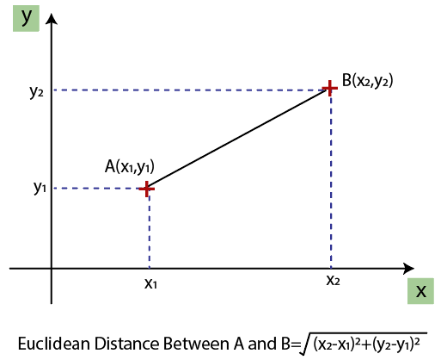
Euclidean distance is given as:

Slide 58
If we compute any two values from age and salary, then salary values will dominate the age values, and it will produce an incorrect result. So to remove this issue, we need to perform feature scaling for machine learning.

Slide 59
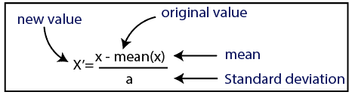
Standardization

Slide 60
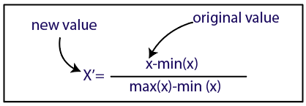
Normalization

Slide 61
For feature scaling, we will import StandardScaler class of sklearn.preprocessing library as:
from sklearn.preprocessing import StandardScaler
Now, we will create the object of StandardScaler class for independent variables or features. And then we will fit and transform the training dataset.
st_x= StandardScaler()
x_train= st_x.fit_transform(x_train)

Slide 62
For test dataset, we will directly apply transform() function instead of fit_transform() because it is already done in training set.
x_test= st_x.transform(x_test)

Slide 63
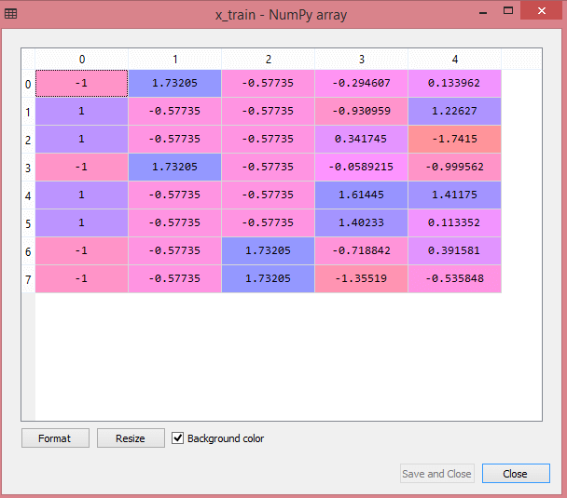
Output:
By executing the above lines of code, we will get the scaled values for x_train and x_test as:
x_train:

Slide 64
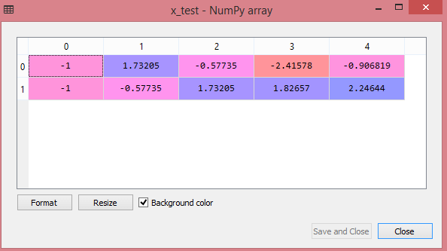
x_test:
As we can see in the above output, all the variables are scaled between values -1 to 1.

Slide 65
Combining all the steps:
Now, in the end, we can combine all the steps together to make our complete code more understandable

Slide 66
# importing libraries
import numpy as nm
import matplotlib.pyplot as mtp
import pandas as pd
#importing datasets
data_set= pd.read_csv('Dataset.csv')
#Extracting Independent Variable
x= data_set.iloc[:, :-1].values
#Extracting Dependent variable
y= data_set.iloc[:, 3].values
#handling missing data(Replacing missing data with the mean value)
from sklearn.preprocessing import Imputer
imputer= Imputer(missing_values ='NaN', strategy='mean', axis = 0)
#Fitting imputer object to the independent varibles x.
imputerimputer= imputer.fit(x[:, 1:3])
#Replacing missing data with the calculated mean value
x[:, 1:3]= imputer.transform(x[:, 1:3])

Slide 67
#for Country Variable
from sklearn.preprocessing import LabelEncoder, OneHotEncoder
label_encoder_x= LabelEncoder()
x[:, 0]= label_encoder_x.fit_transform(x[:, 0])
#Encoding for dummy variables
onehot_encoder= OneHotEncoder(categorical_features= [0])
x= onehot_encoder.fit_transform(x).toarray()
#encoding for purchased variable
labelencoder_y= LabelEncoder()
y= labelencoder_y.fit_transform(y)
# Splitting the dataset into training and test set.
from sklearn.model_selection import train_test_split
x_train, x_test, y_train, y_test= train_test_split(x, y, test_size= 0.2, random_state=0)
#Feature Scaling of datasets
from sklearn.preprocessing import StandardScaler
st_x= StandardScaler()
x_train= st_x.fit_transform(x_train)
x_test= st_x.transform(x_test)

